Slide 1

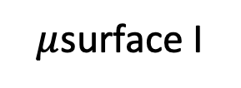
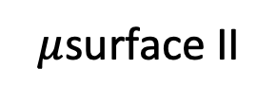
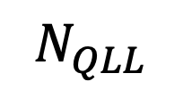
Mesoscale variables
Water vapor
Deposition & sublimation
Surface diffusion
$μ$surface II
$μ$surface I
$$N_{QLL}$$
$$N_{tot}$$
Quasi-liquid/ice equilibration
$$N_{ice}$$
Ice

Slide 2
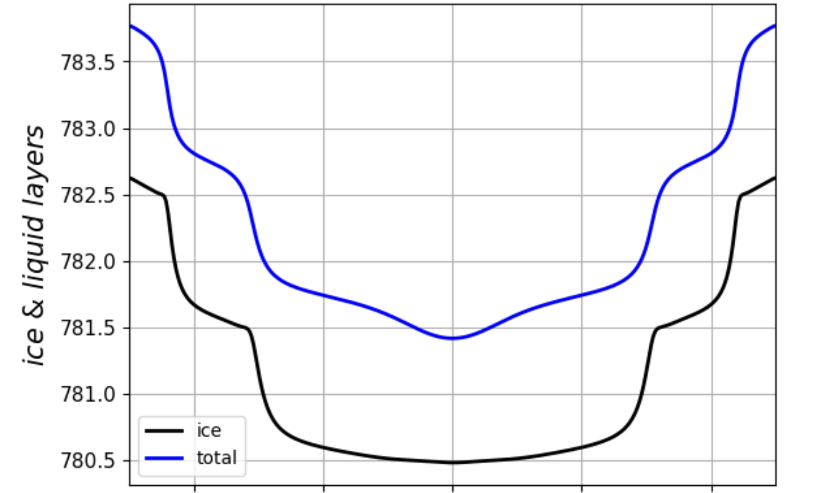
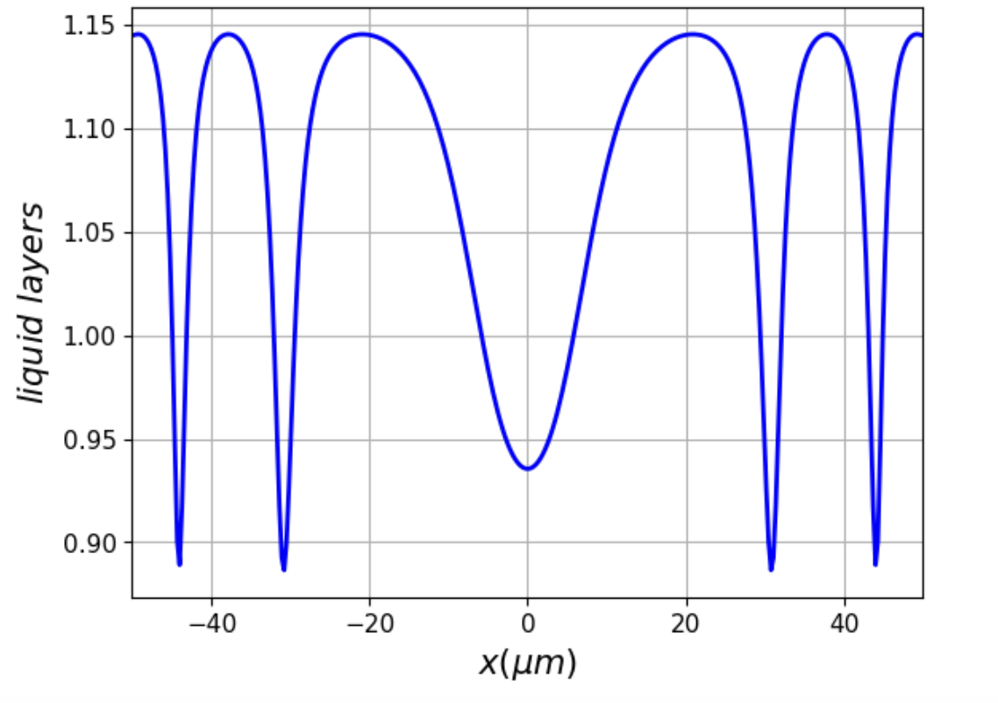




Figure 3
$$(a)$$
$μ$surface II
$μ$surface I
$$(b)$$
II
II
II
I
I

Slide 3
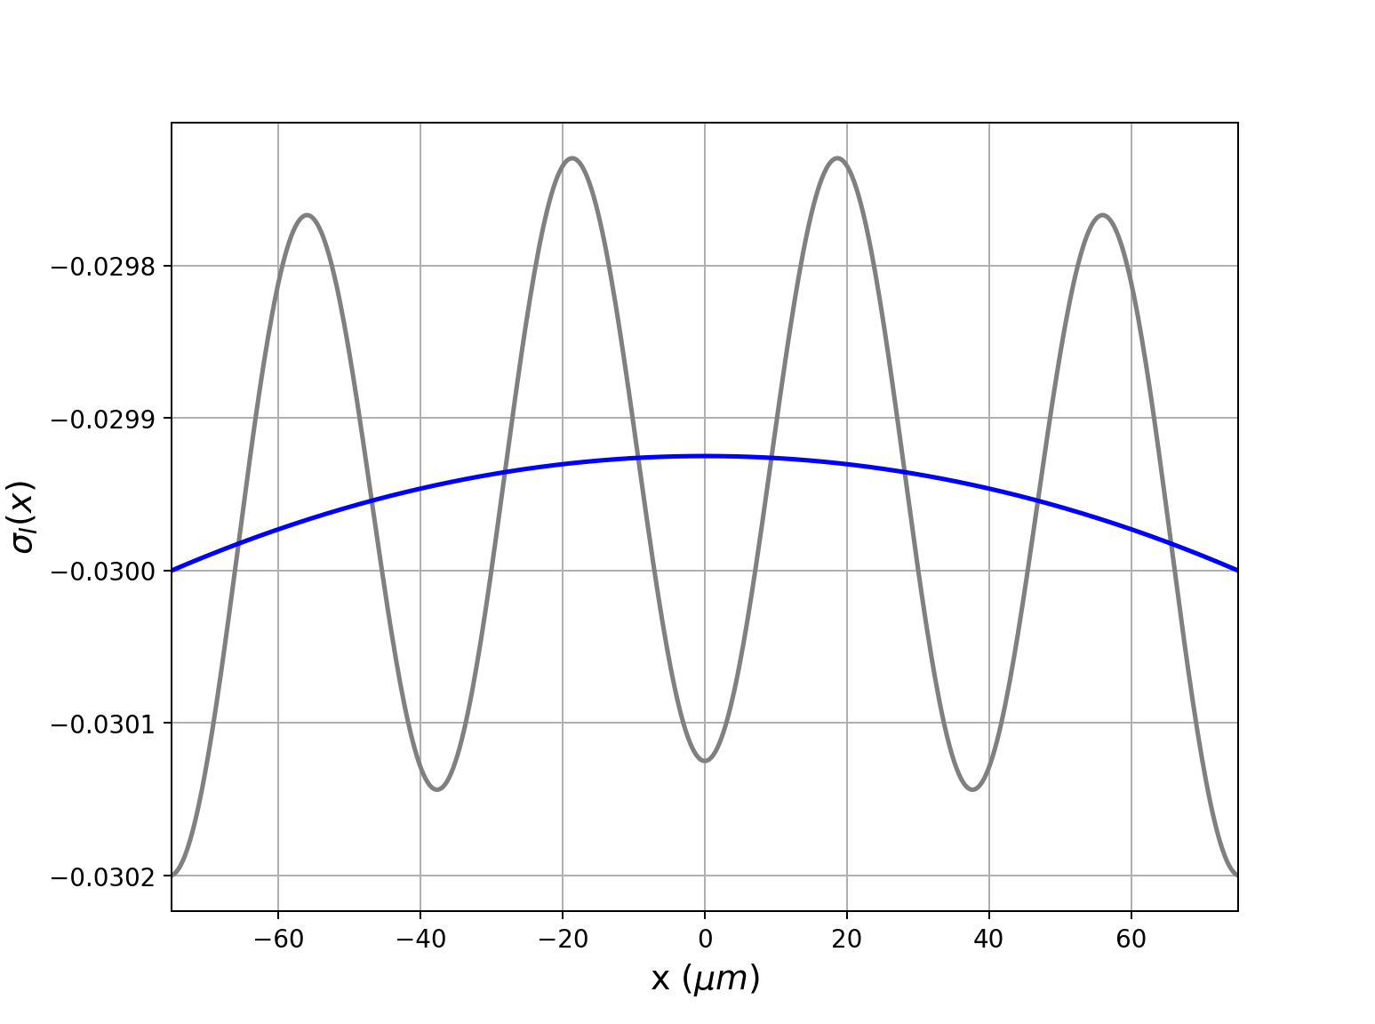

Slide 4
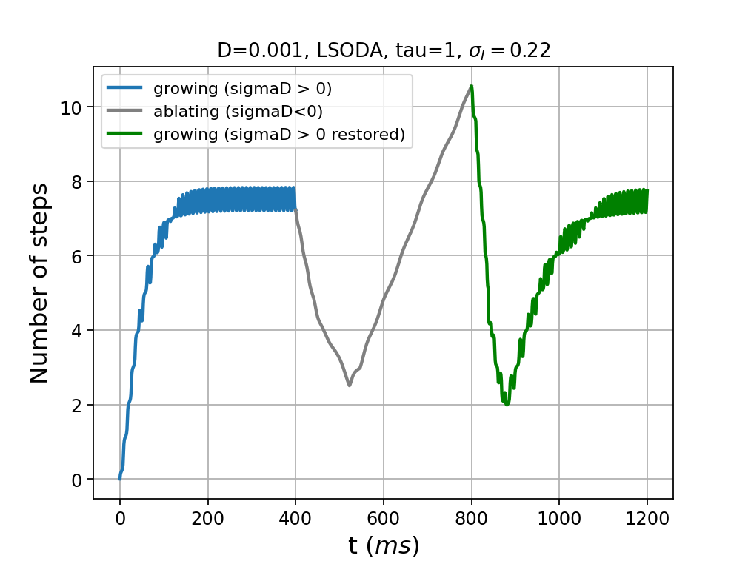
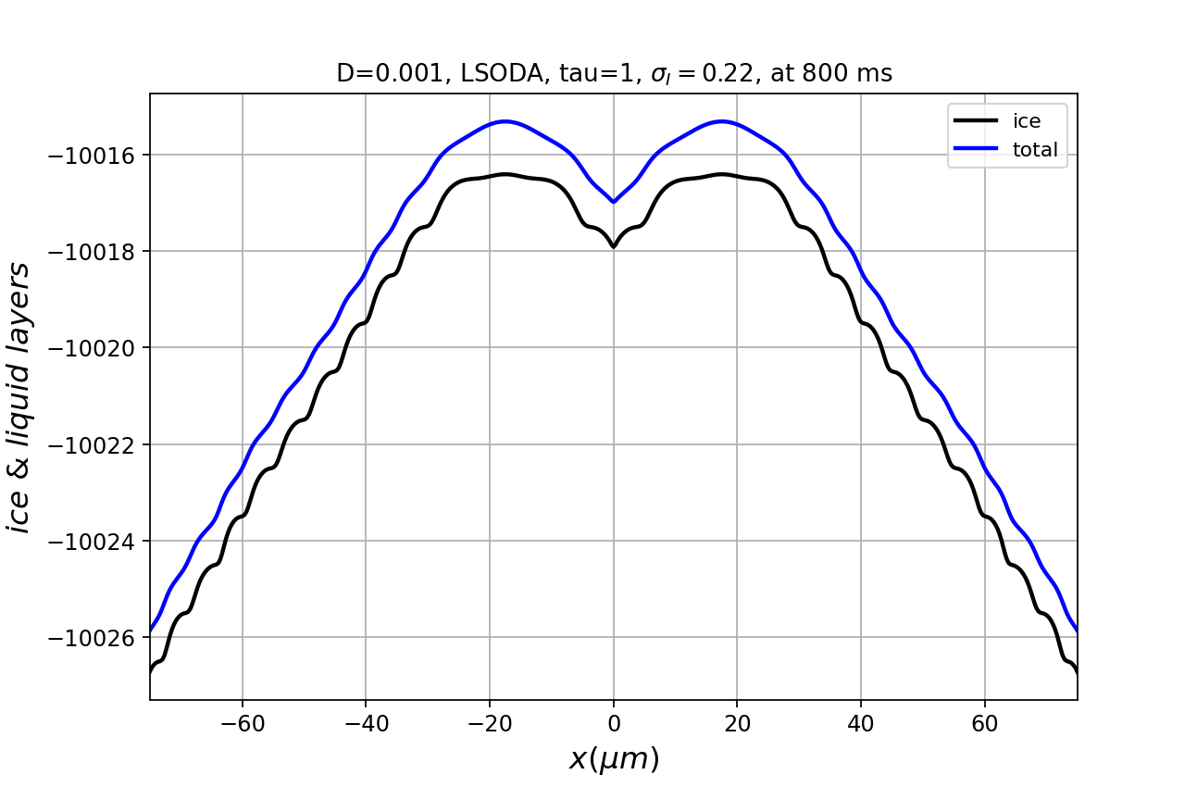
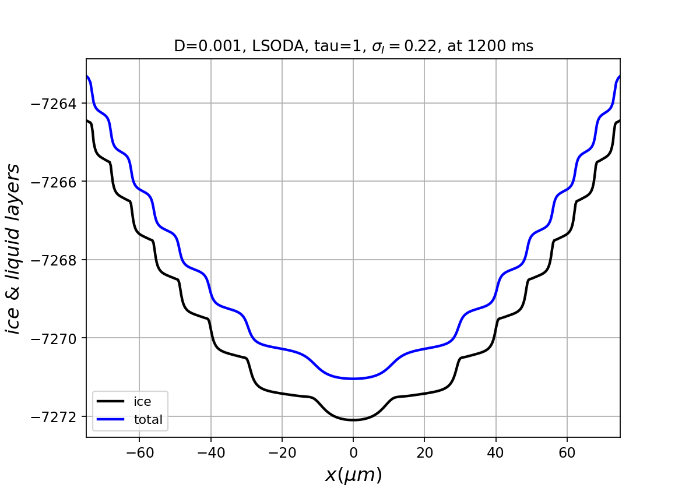
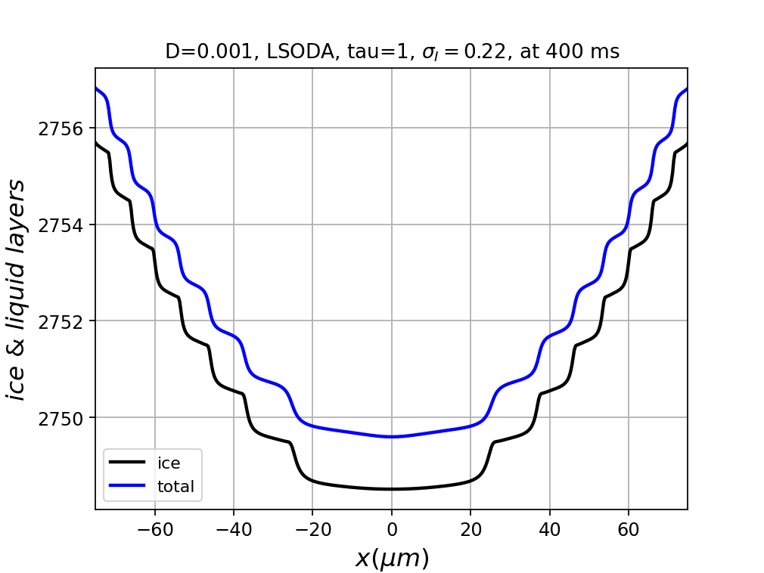
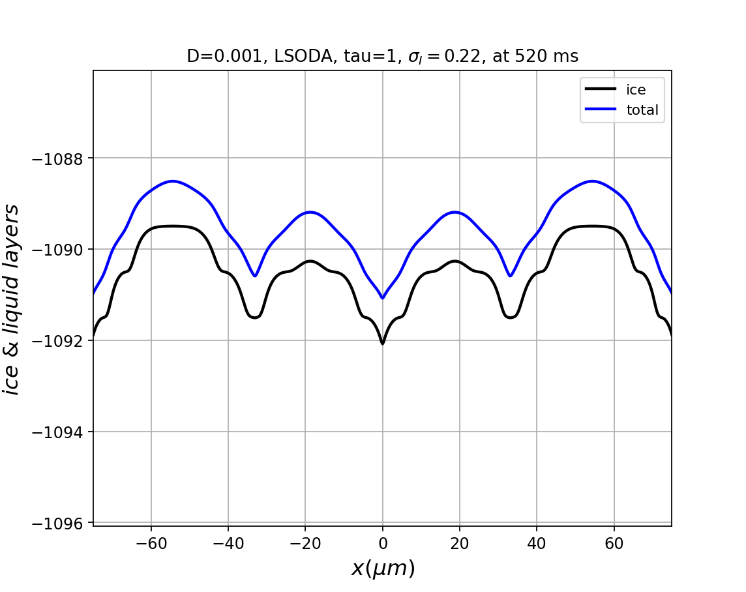

Slide 5
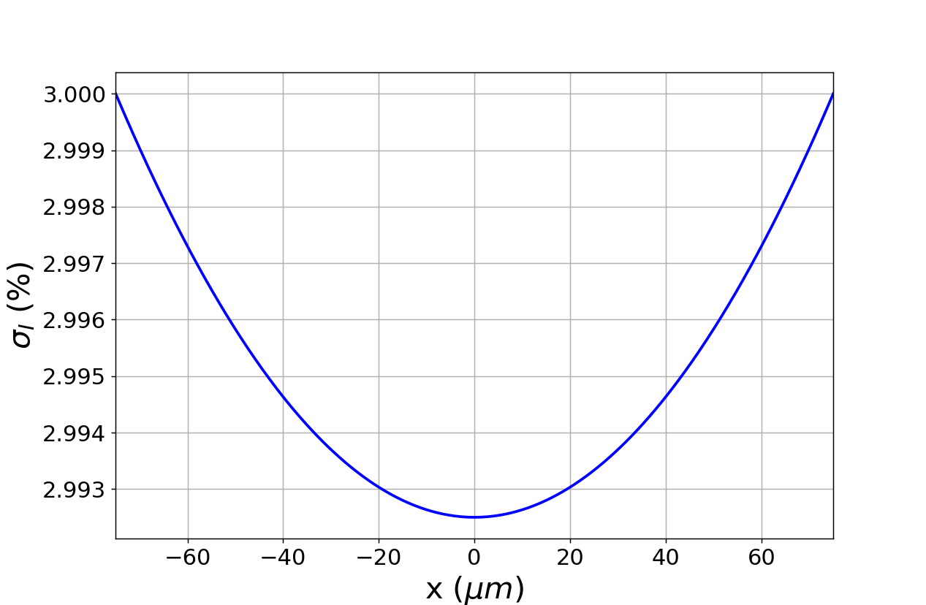
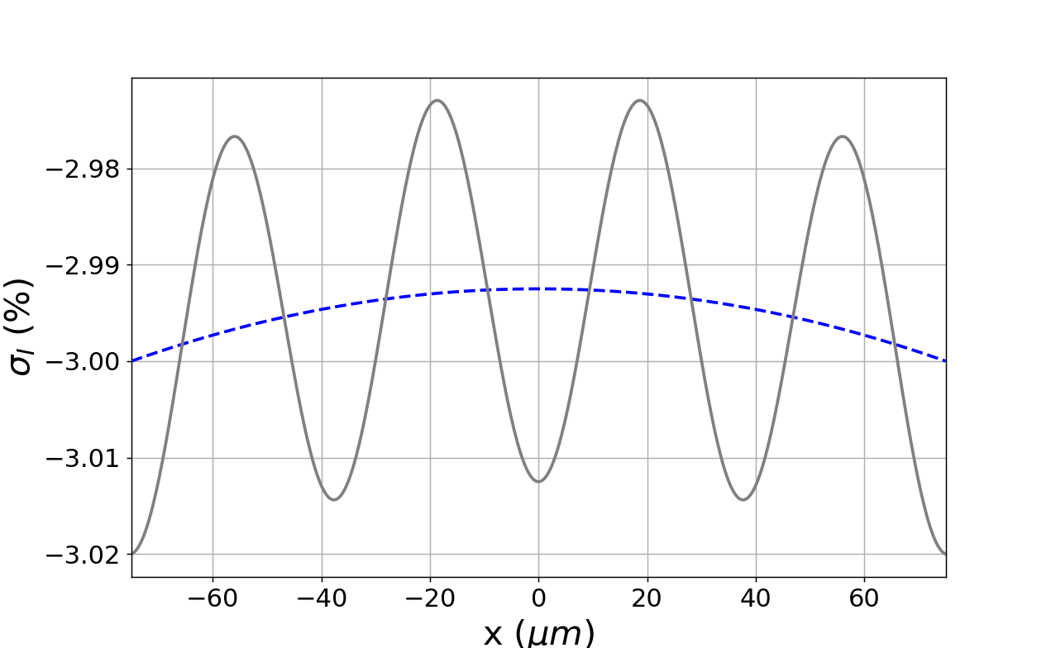
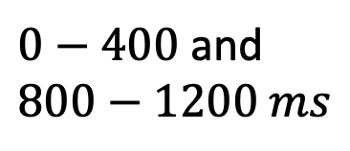

$0−400$ and $800−1200 ms$
B
A
C
$400−800 ms$
A
C
B

Slide 7
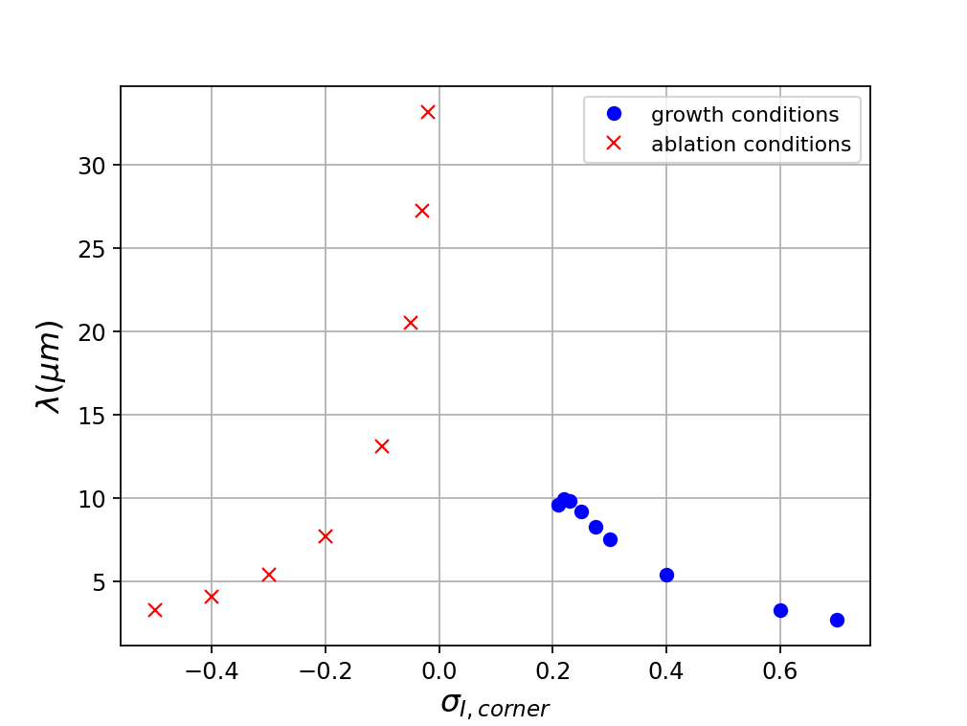
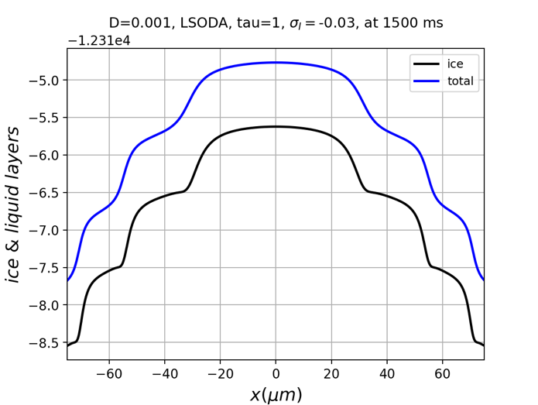
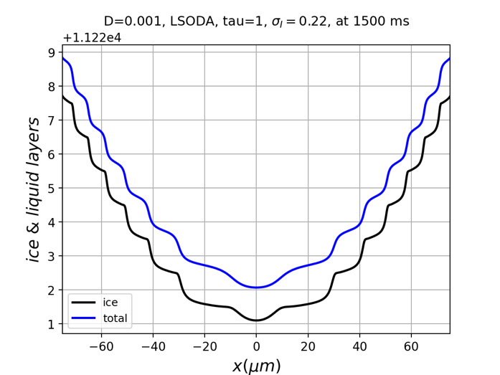
Old data – do not use
Concave ablation facets transition to rounding
Convex growth facets
transitions to
dendritic growth

Slide 8
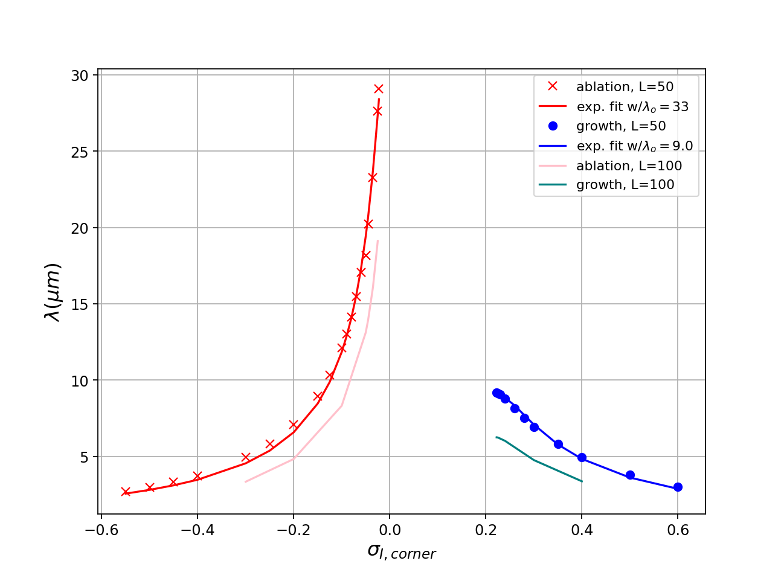
Old data – do not use
Concave ablation facets transition to rounding
Convex growth facets
transition to
dendritic growth

Slide 9
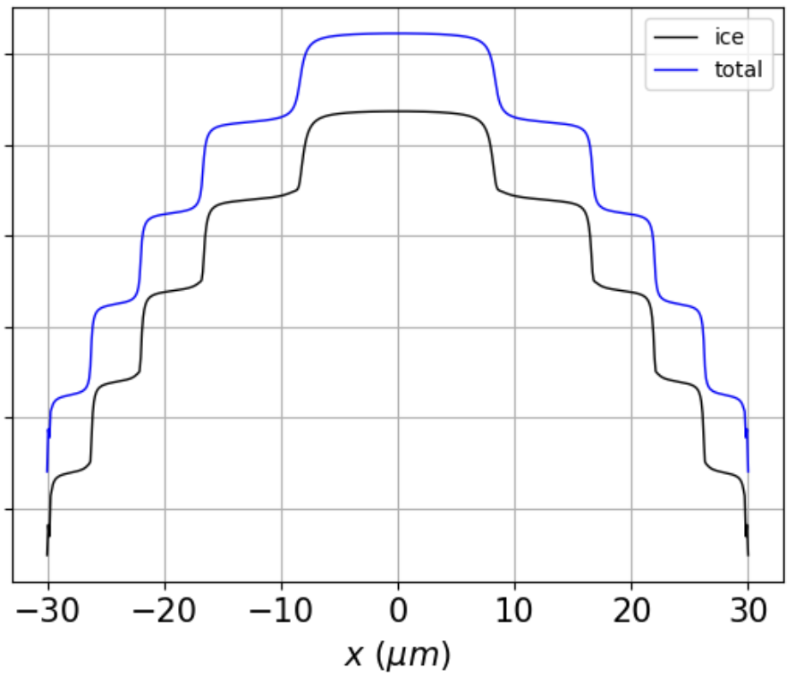
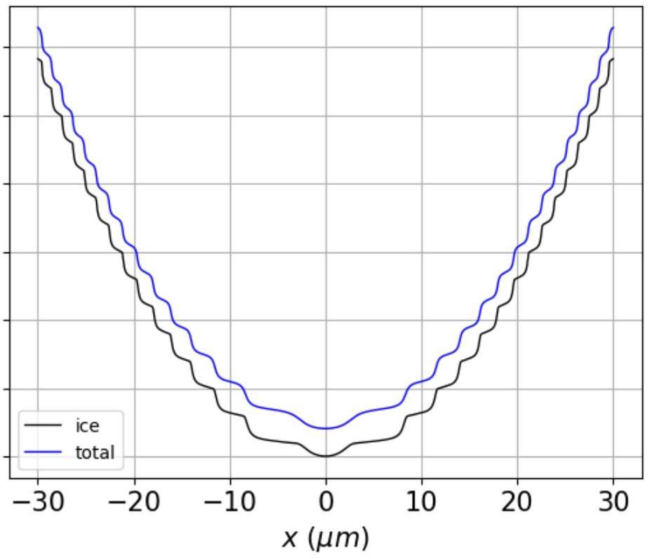
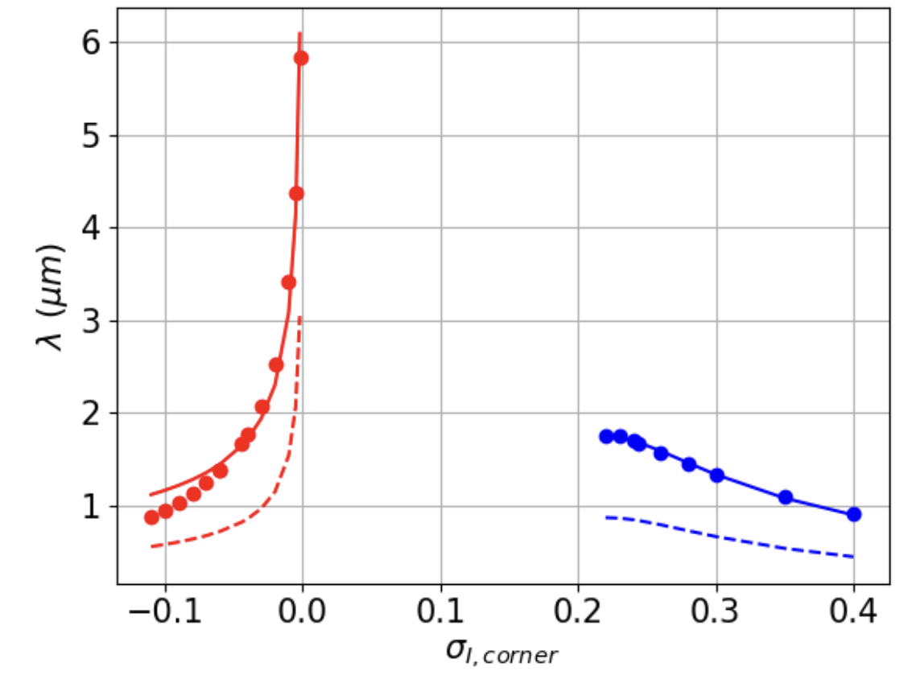
Use this figure
Convex facets
Concave facets
Ablation conditions
No growth or ablation
Growth conditions

Slide 10
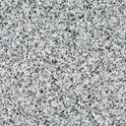
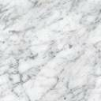
Need a real image here

Slide 11
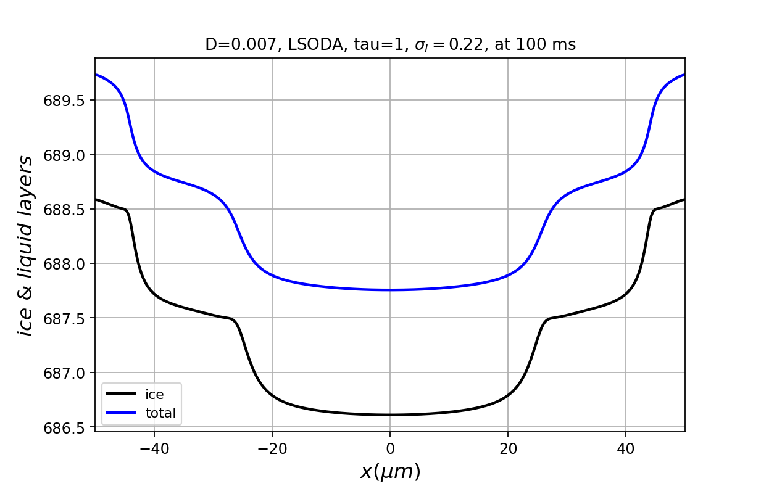
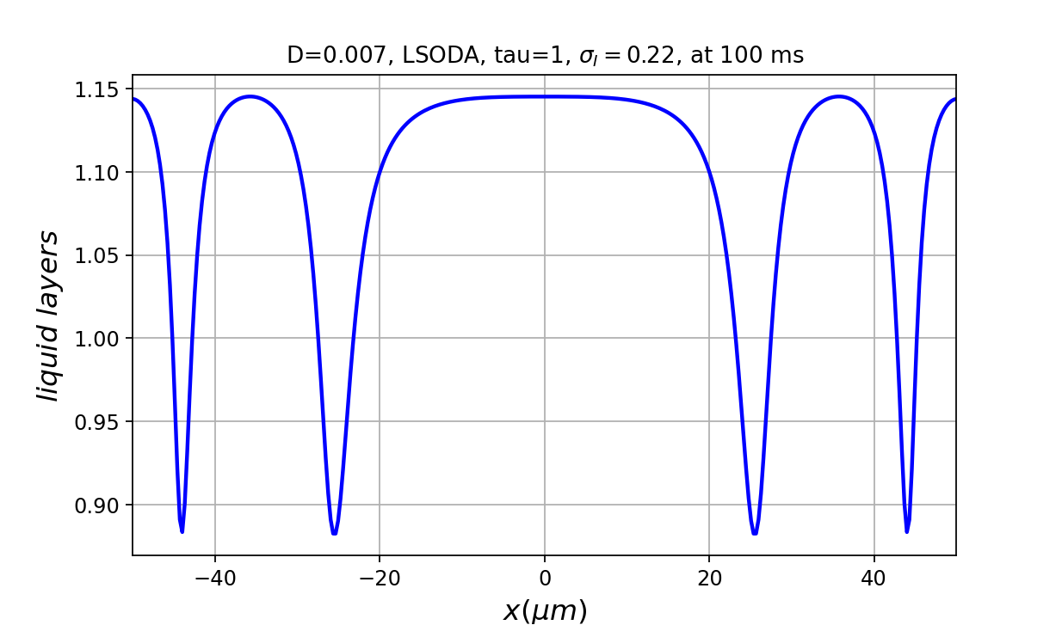


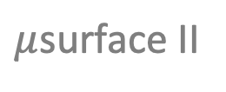
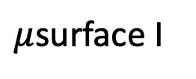
(a)
$μ$surface I
$μ$surface II
$$λ_{corner}$$
$$λ_{center}$$
II
II
(b)
I
I’

Slide 12
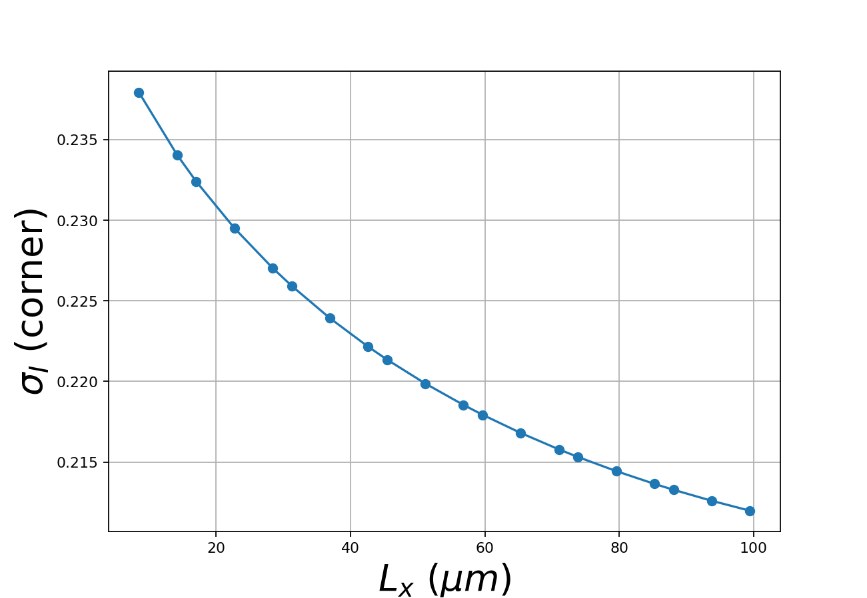
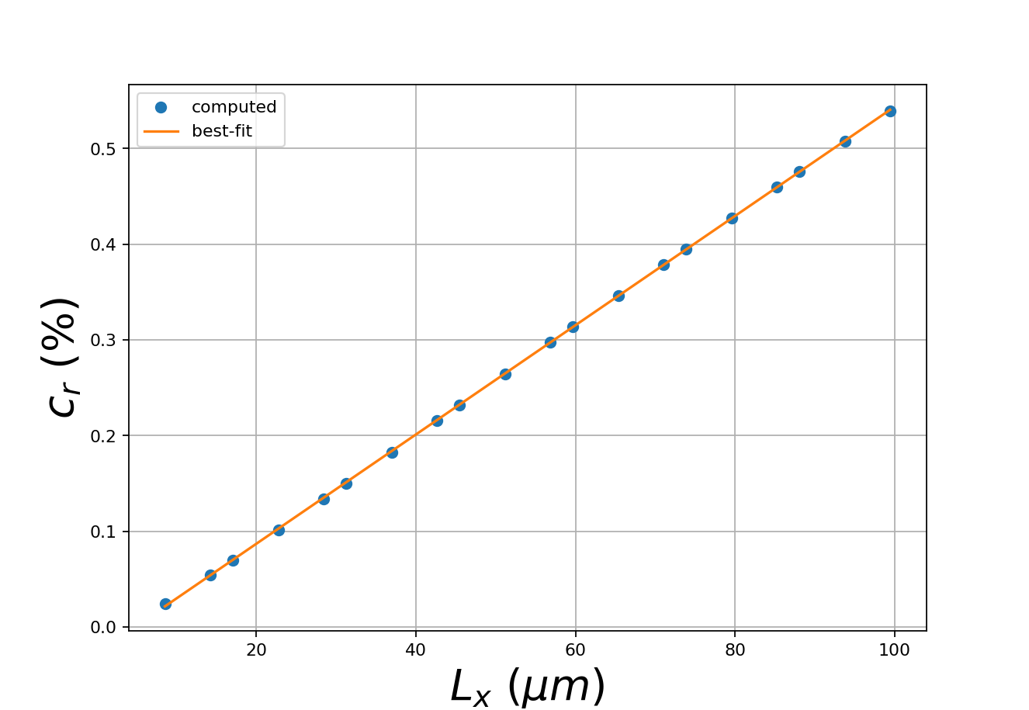

Slide 13
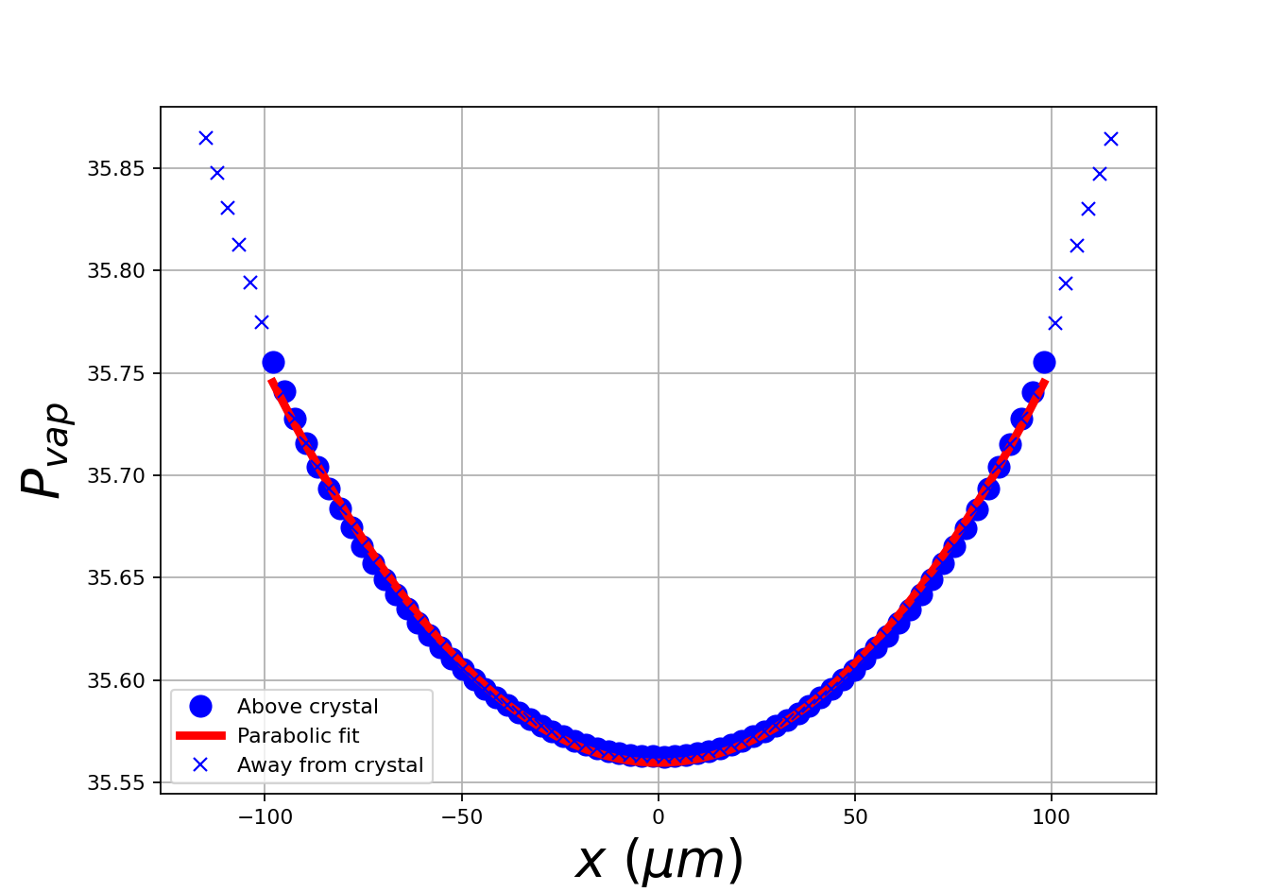

Slide 14
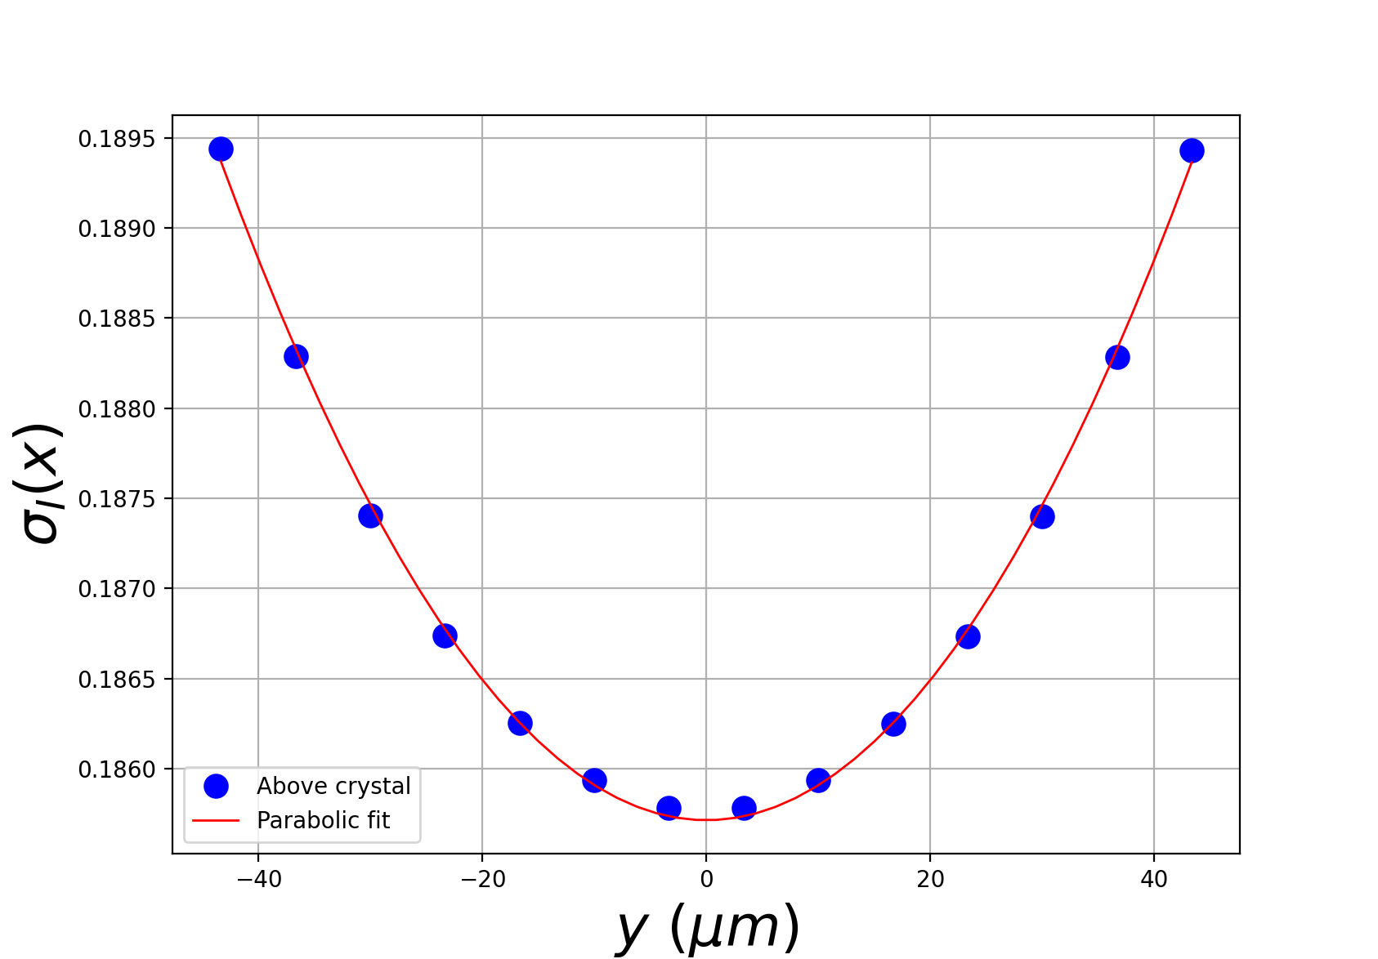

Slide 15
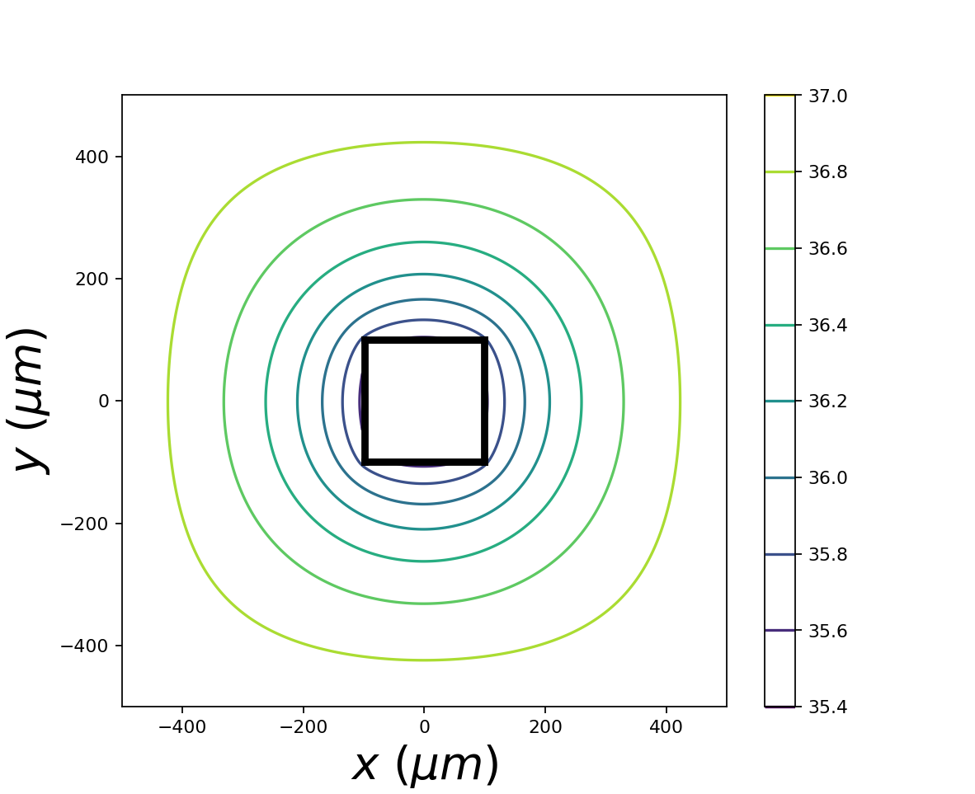

Slide 16
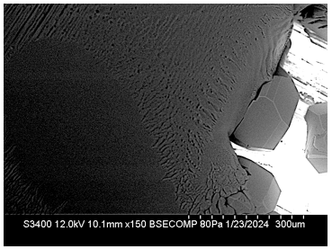
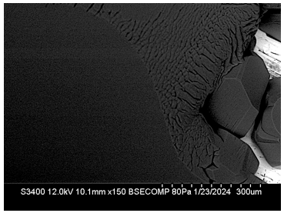

Slide 17
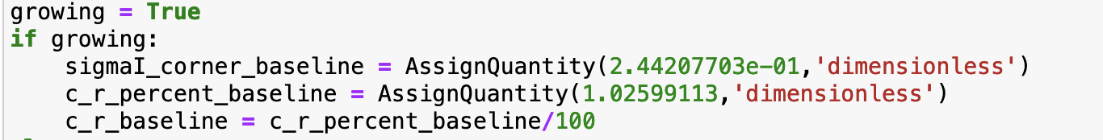
For Figure 4 (growing)

Slide 18
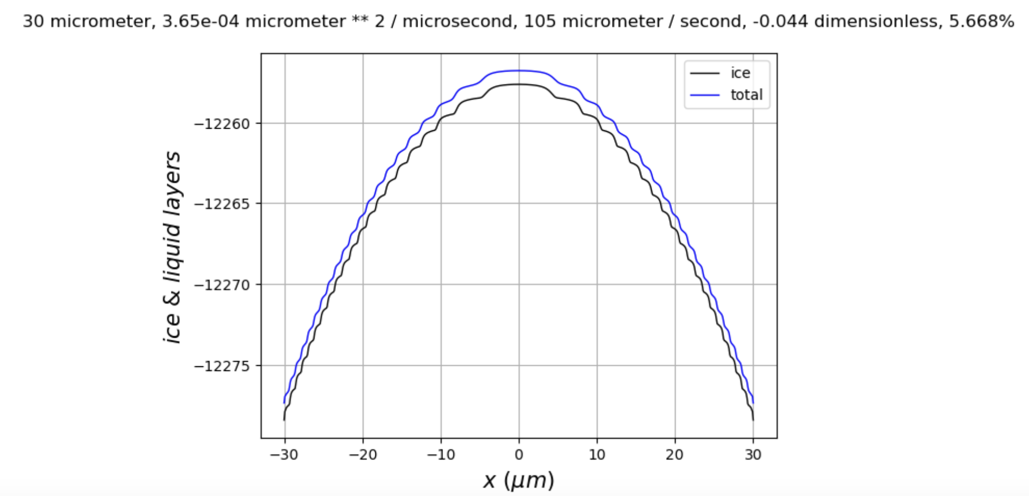
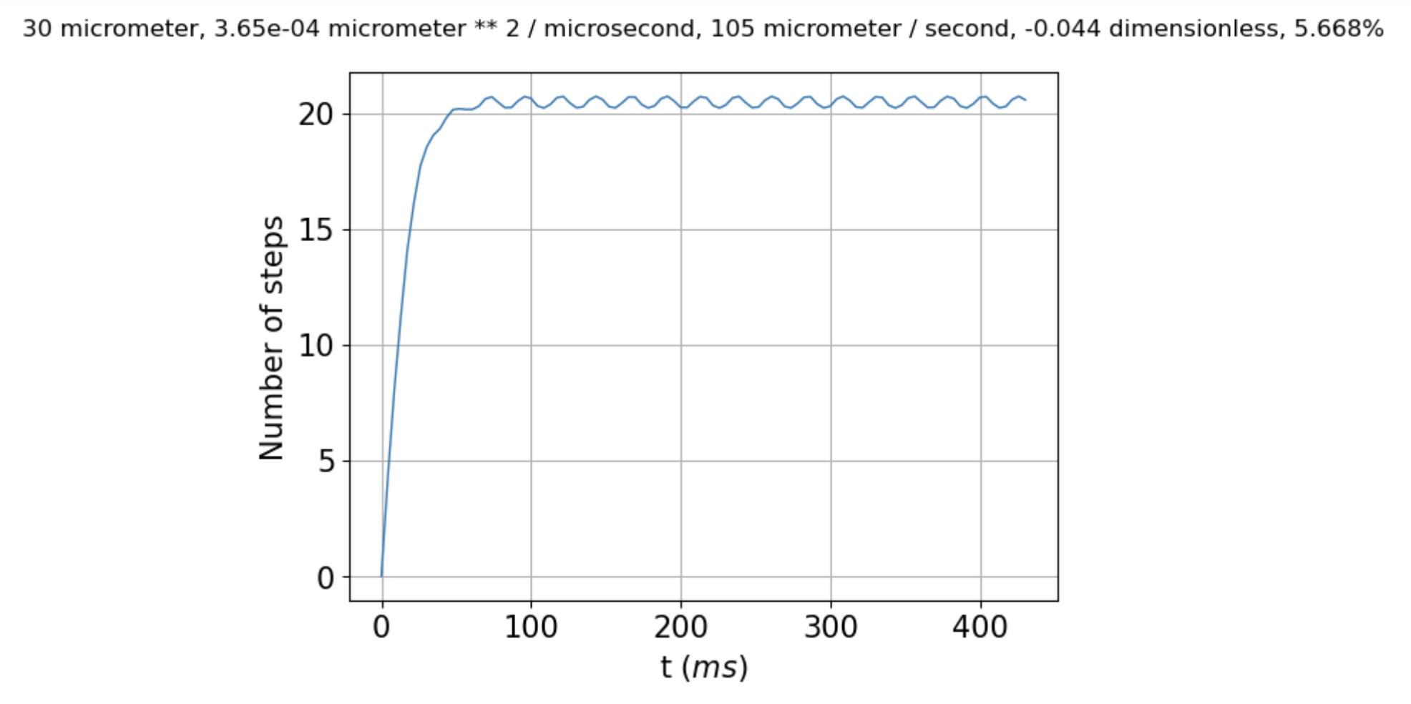
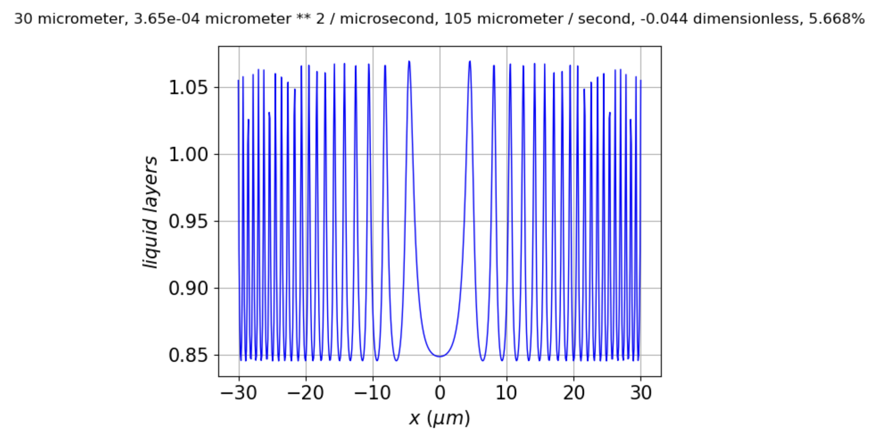
For Figure 4 (ablating)

Slide 19
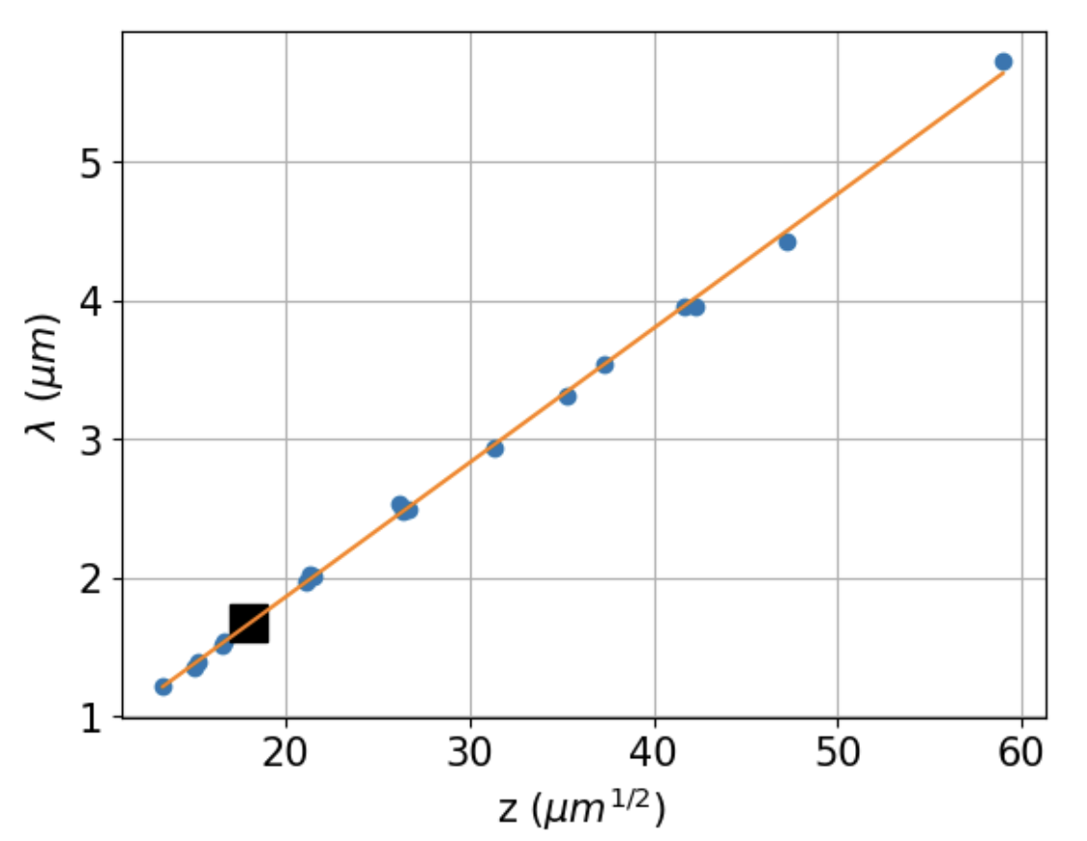
This is for a set of growing scenarios, for Fig. 7. Strategy A.

Slide 20
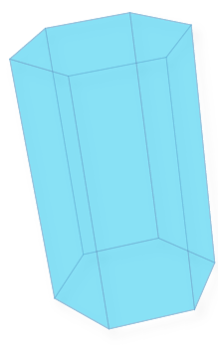

Water vapor
Ice crystal
(3D)
Ice crystal
(2D)
Ice crystal
(2D)

Slide 21








$$−L$$
$$L$$
$$30°$$
$$x$$
$$r_{hex}$$
$$r_{eff}$$
$${r′}_{hex}$$
$$r_{hex}$$

Slide 22
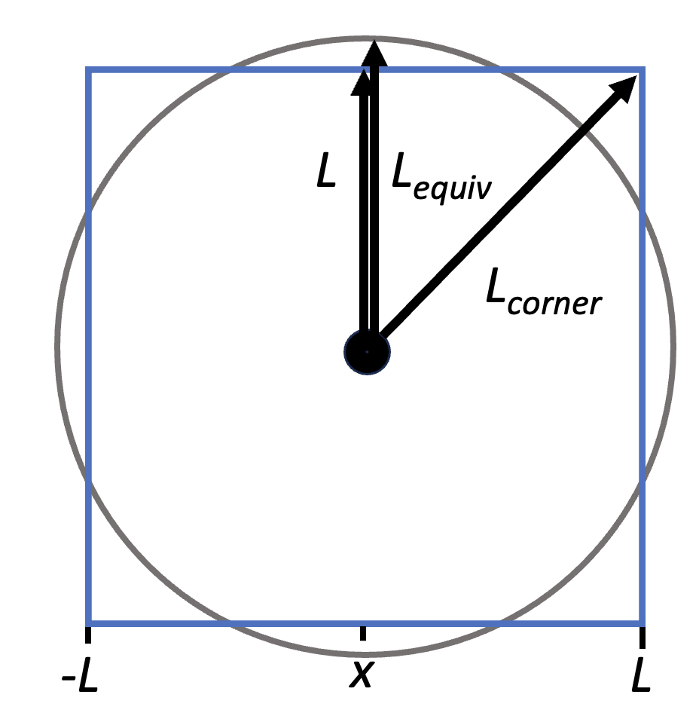
L
L_{equiv}
L_{corner}
-L
x
L

Slide 23
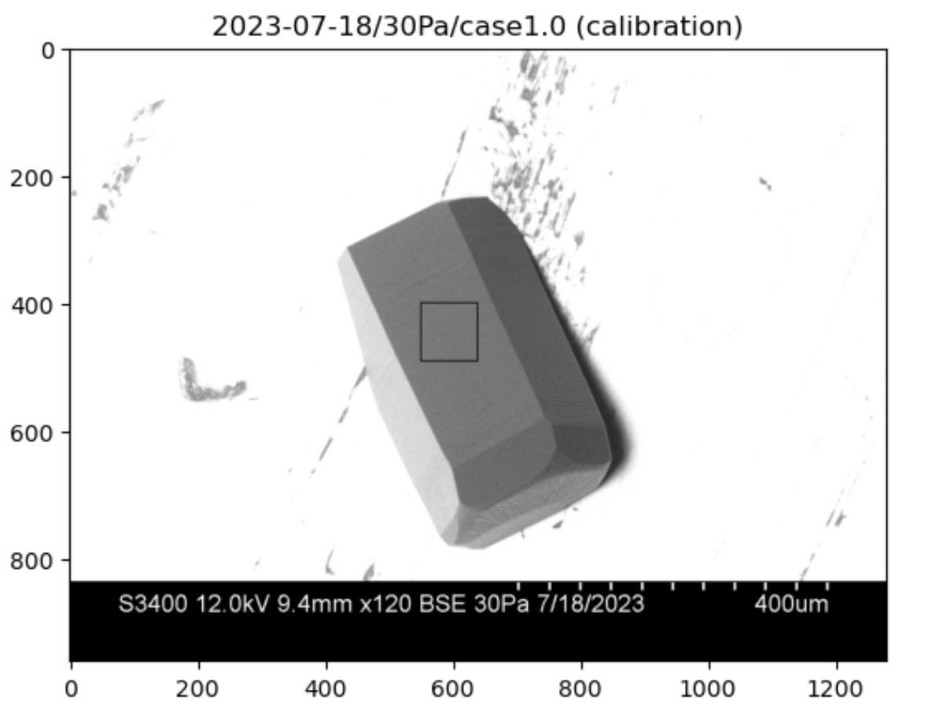
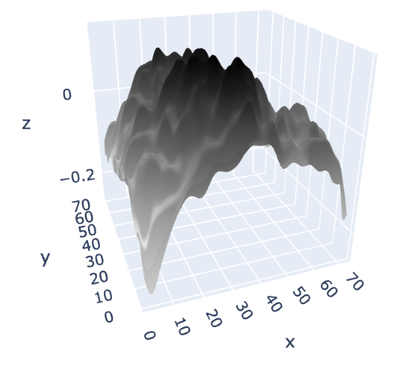
GNBF/SEM
retrieval region
y
x
c
a

Slide 24
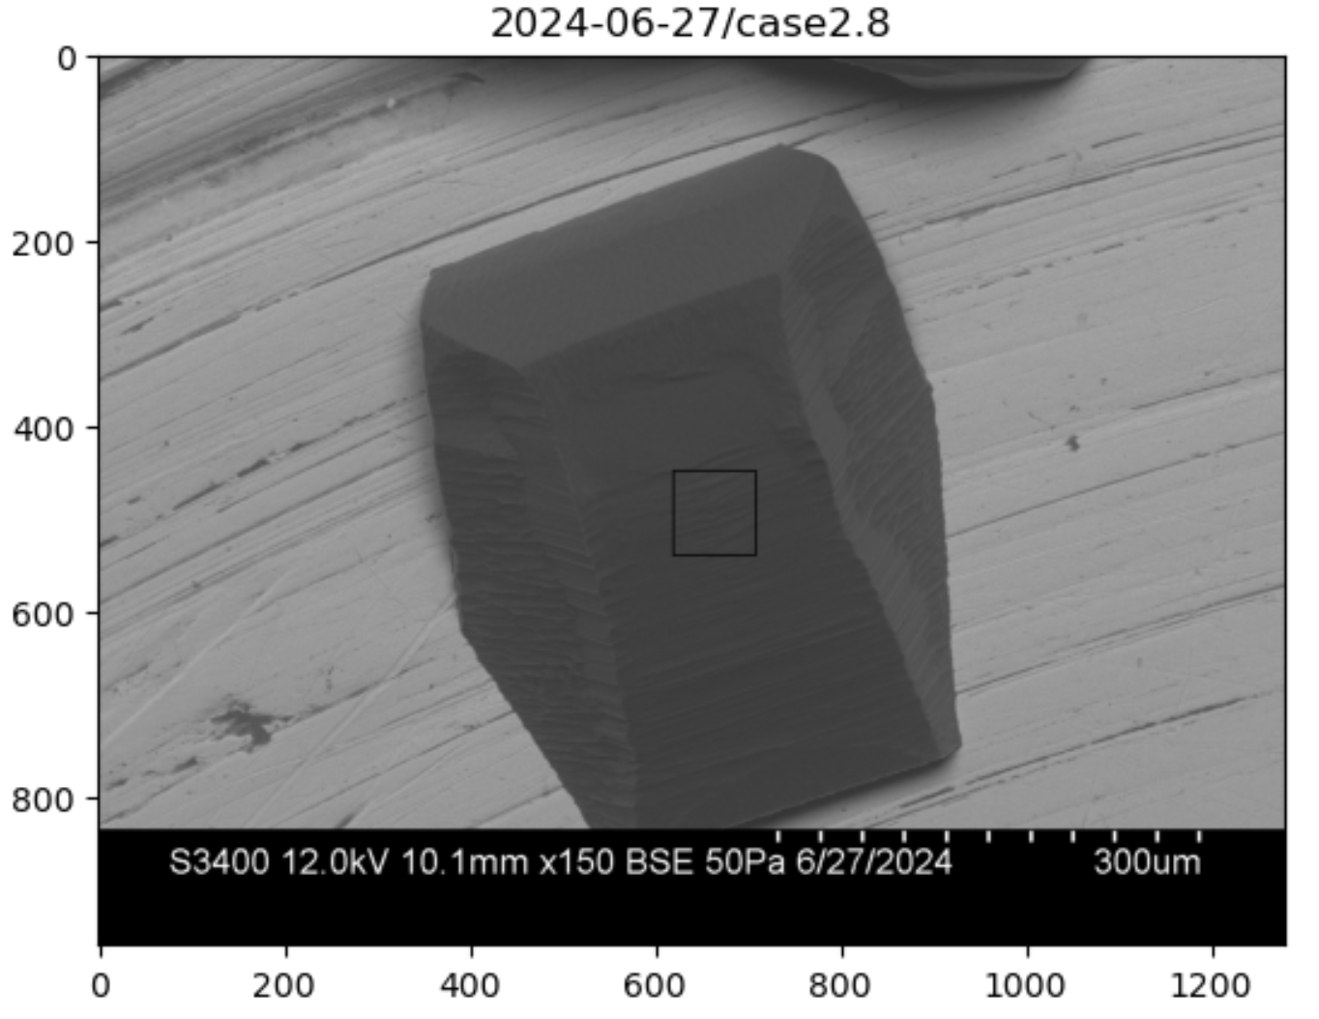
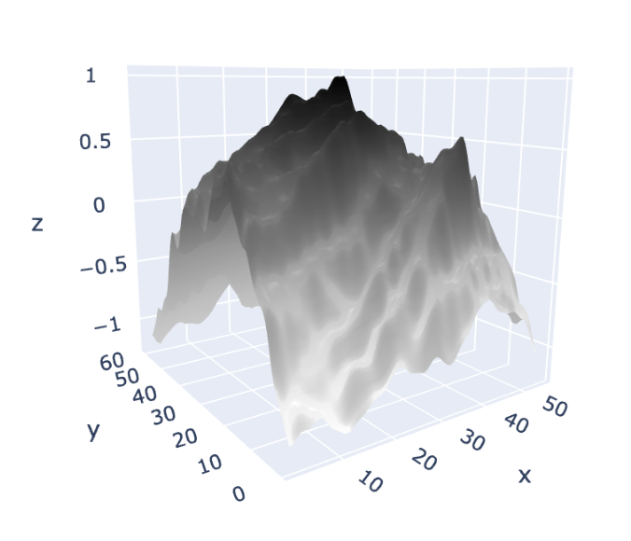
GNBF/SEM
retrieval region
y
x

Slide 25
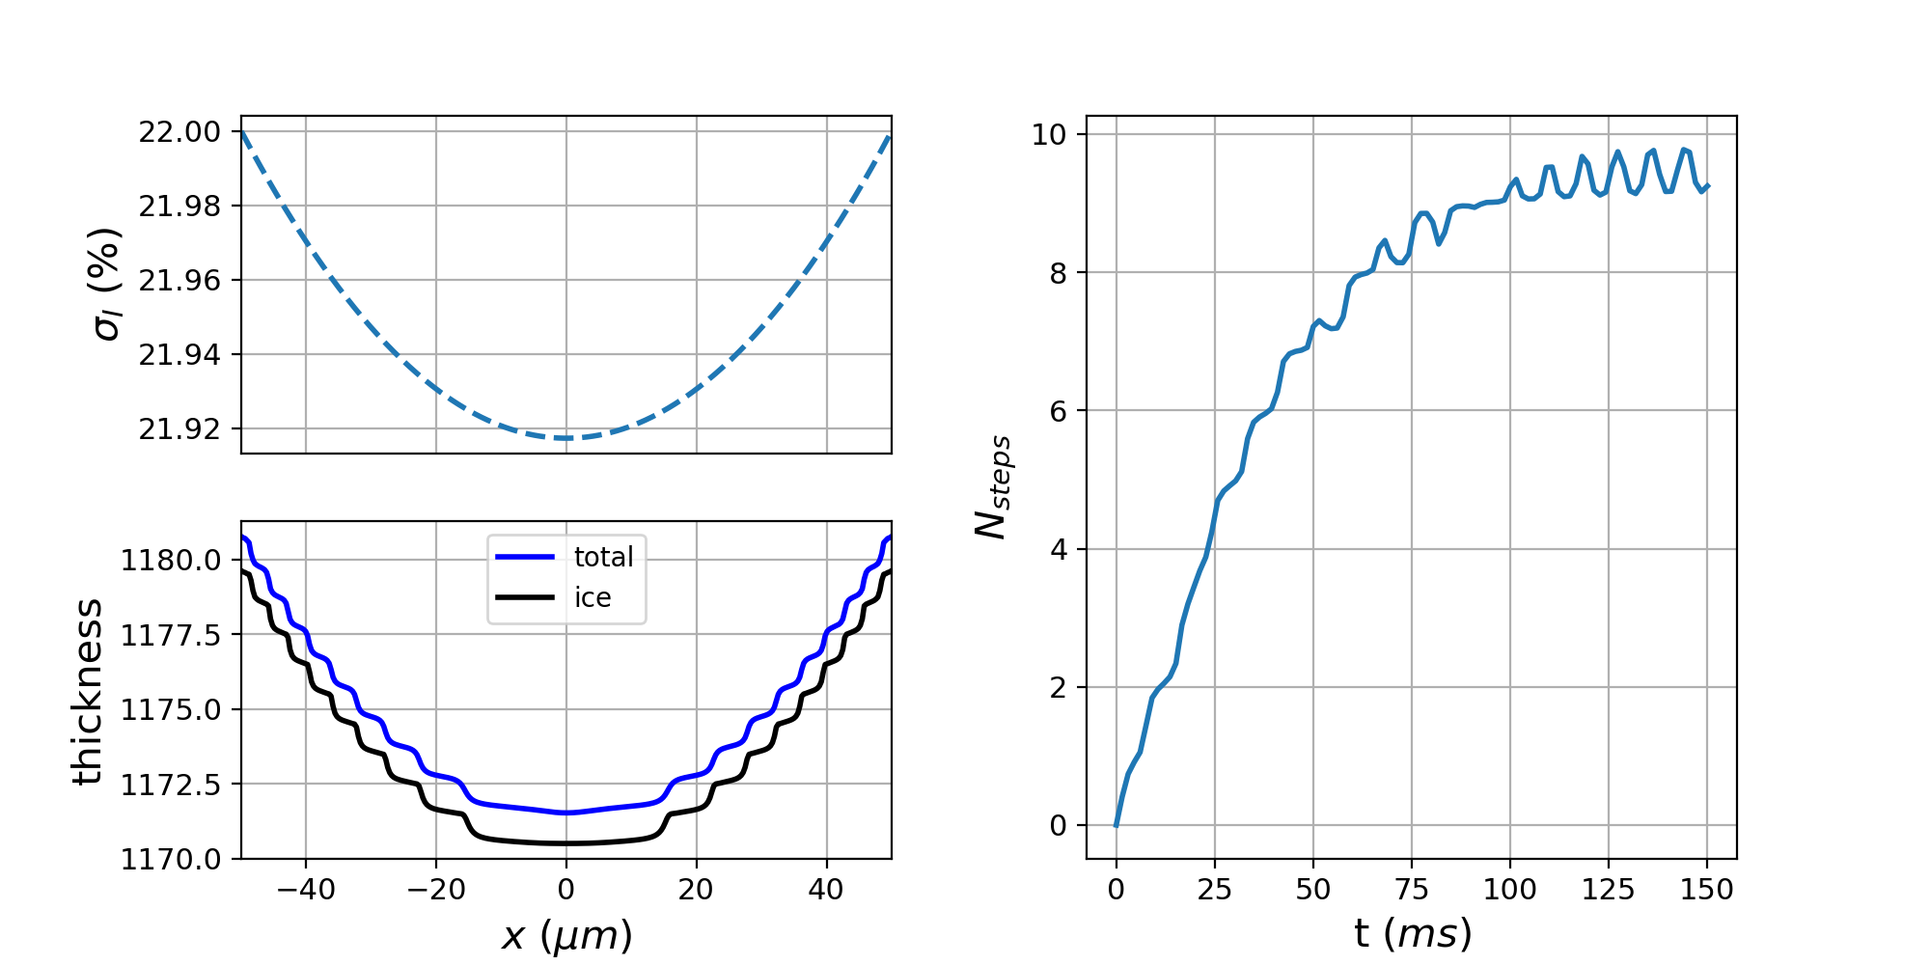
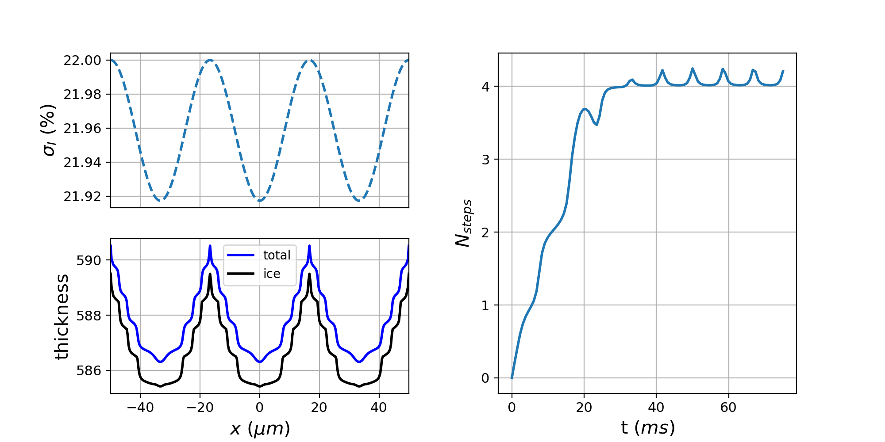
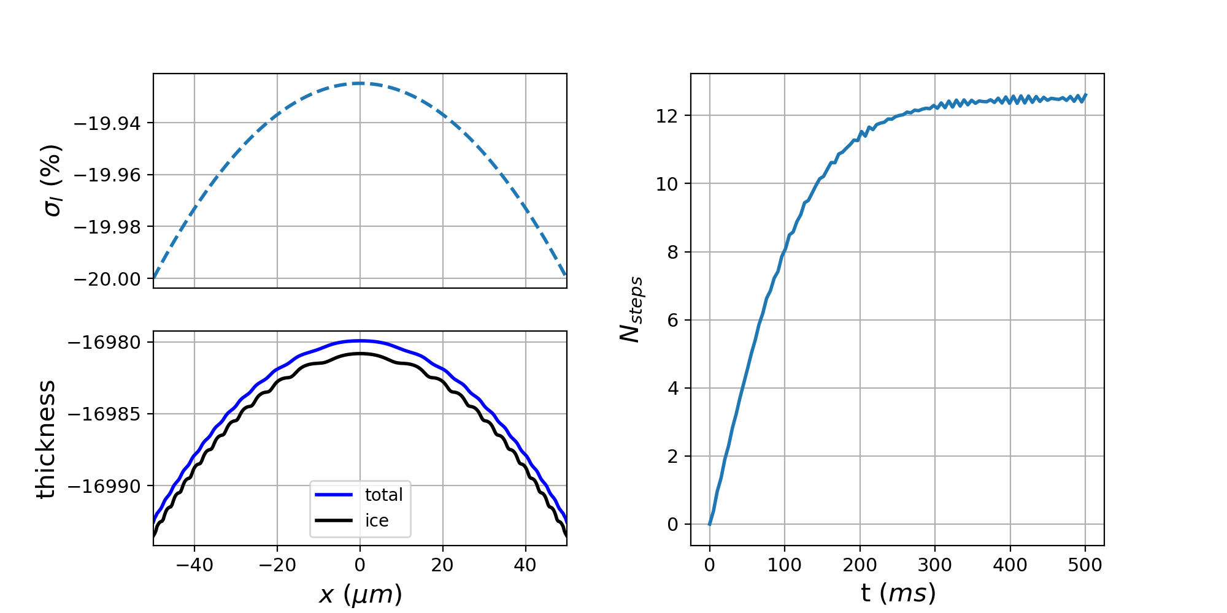
(a)
(b)
(c)

Slide 26
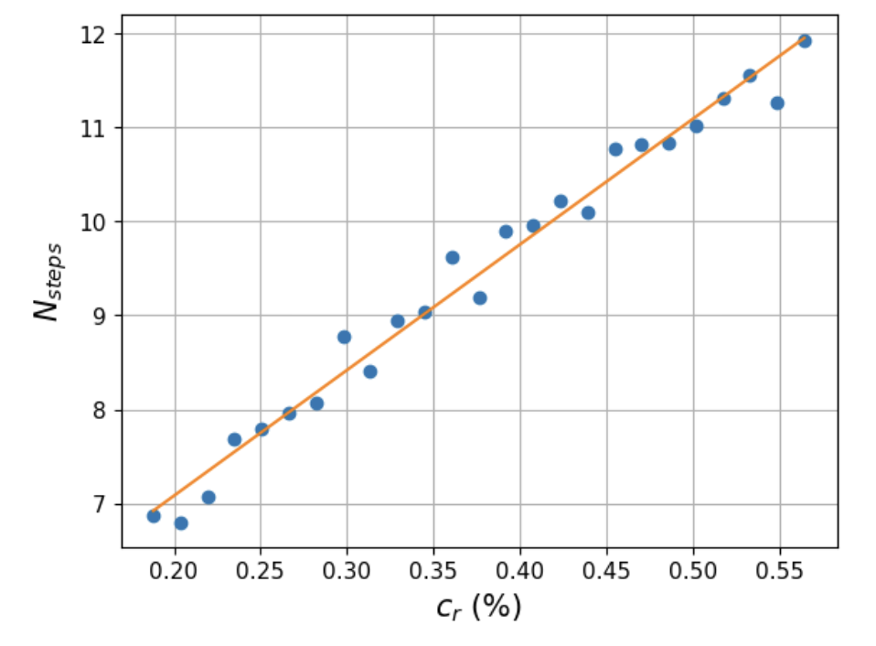
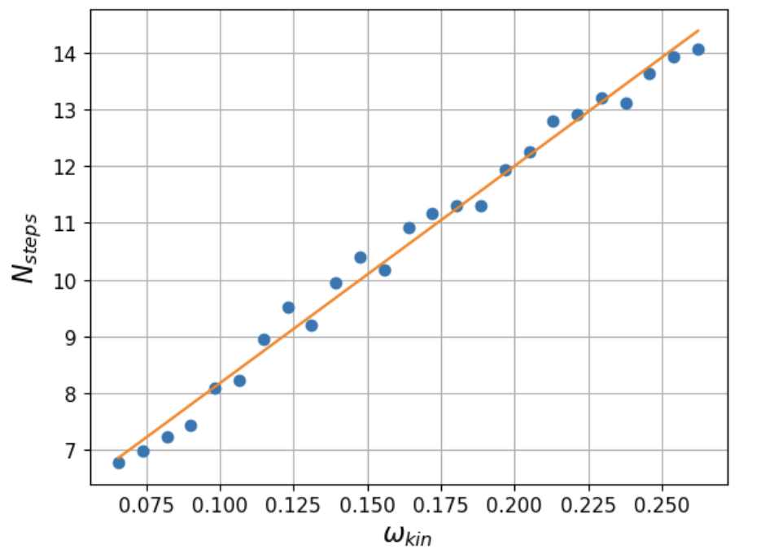
(a)
(b)

